Slide 1
Chart Types
RX 319
Introduction to Healthcare Analytics

Slide 2
Learning Objectives
Describe the main chart types.
Determine which chart type should be used in a certain scenario.

Slide 3
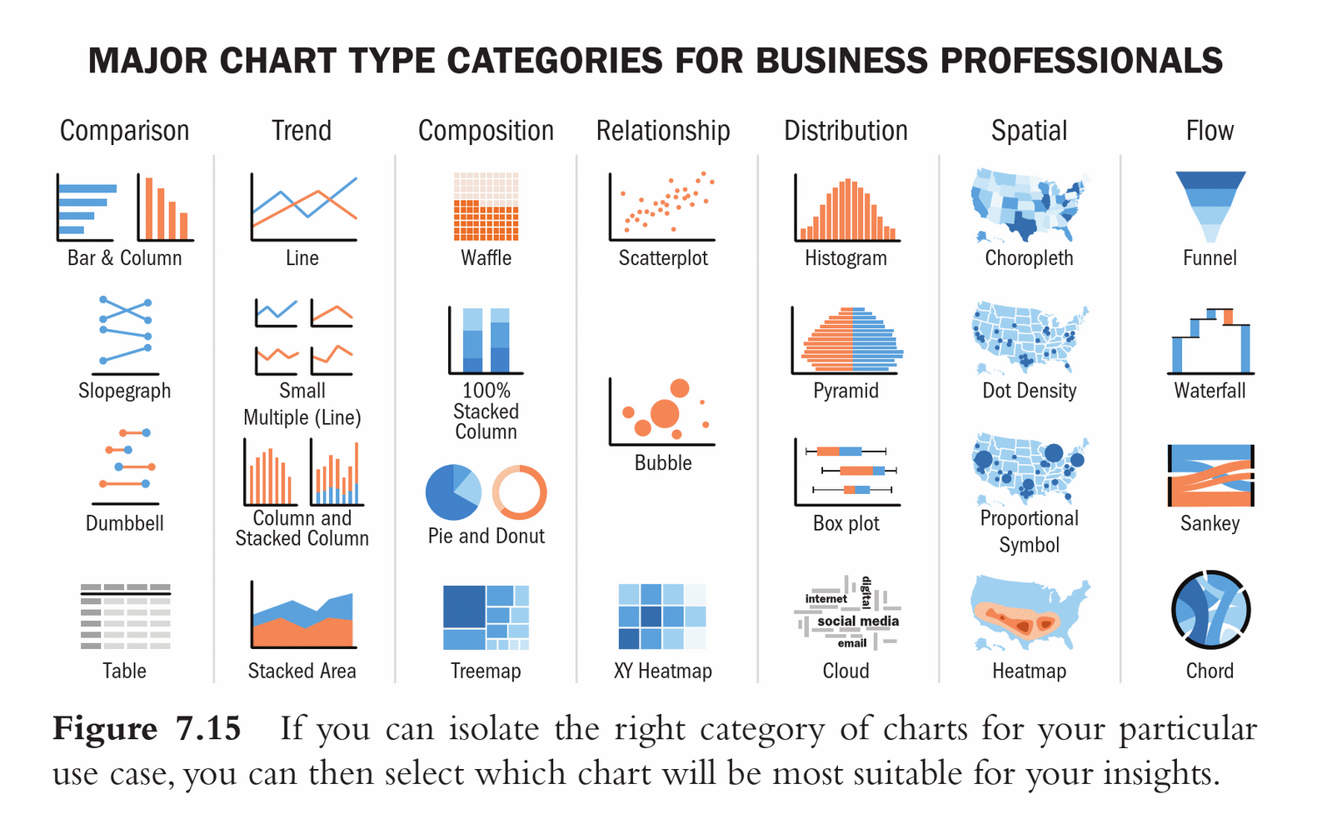
So many charts, so little class time…
Dykes B. Effective Data Storytelling: How to Drive Change with Data, Narrative, and Visuals

Slide 4
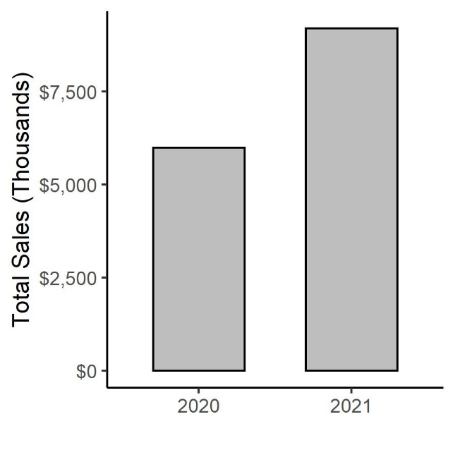
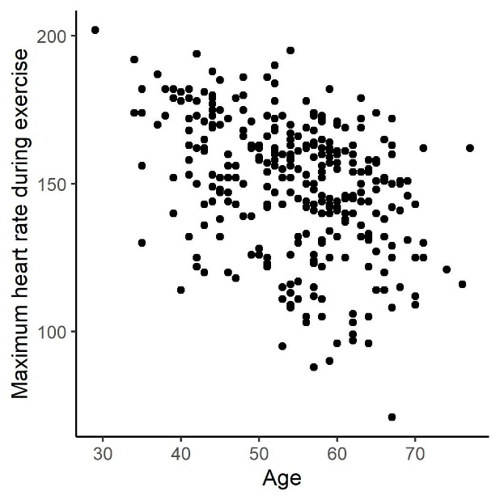
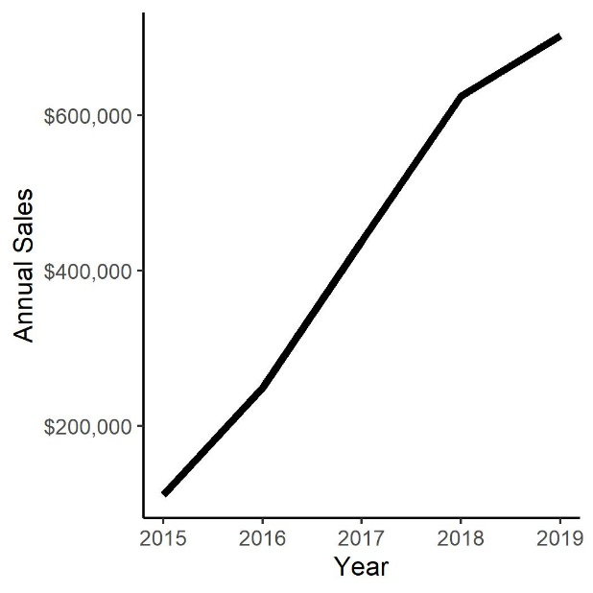
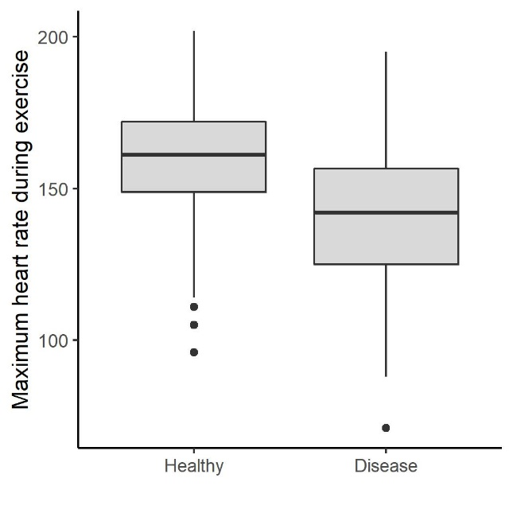
The four main chart types
Bars
Dots
Lines
Boxes

Slide 5
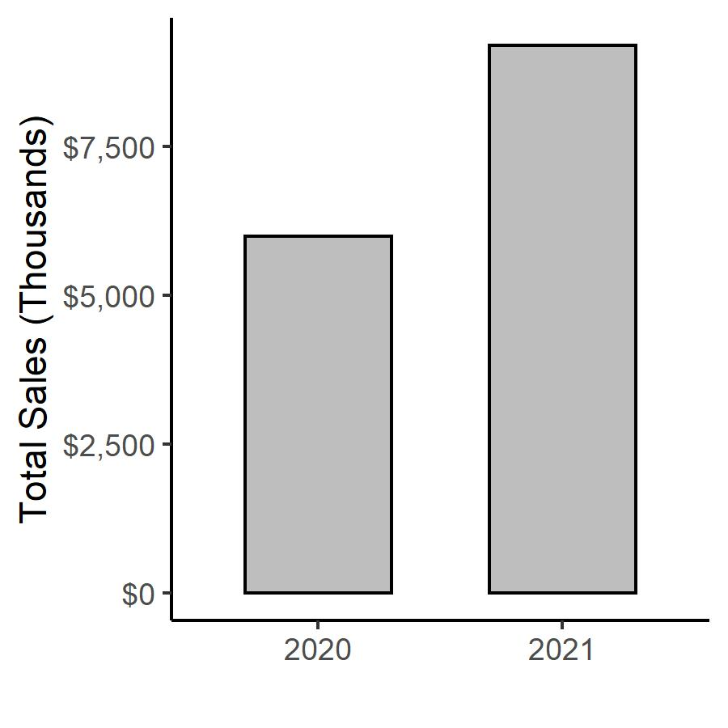
Bars are nice for simple data
Year | Total Sales (Thousands)
2020 | $6,000
2021 | $9,200

Slide 6
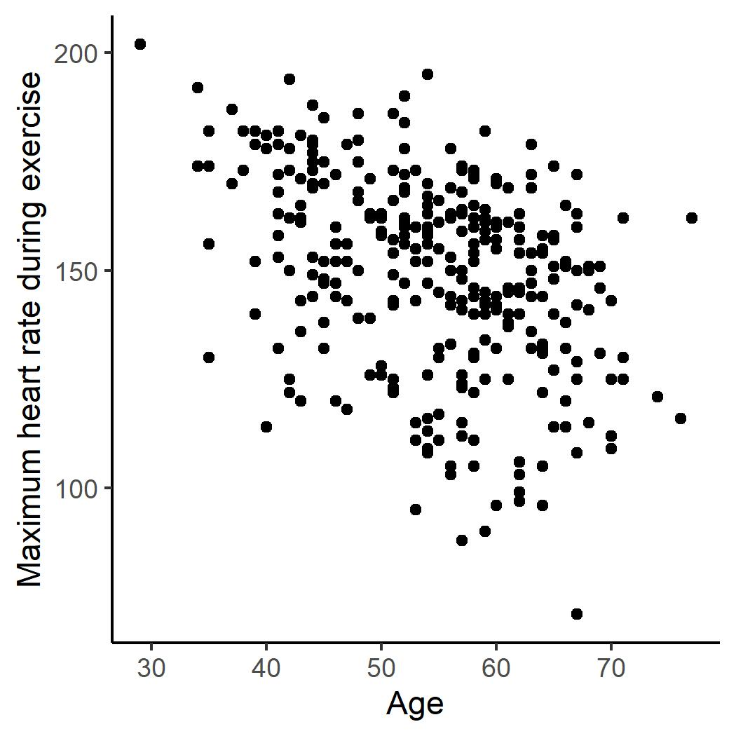
Dots help you see relationships
Age | Maximum HR | … | Heart Disease?
41 | 172 | … | Healthy
62 | 160 |  | Disease
57 | 163 |  | Healthy
56 | 153 |  | Healthy
48 | 139 |  | Healthy
58 | 162 |  | Healthy
50 | 158 |  | Healthy
58 | 172 |  | Healthy
66 | 114 |  | Healthy
69 | 151 |  | Healthy
65 | 114 |  | Disease
71 | 162 |  | Healthy
61 | 169 |  | Disease
65 | 157 |  | Healthy
41 | 168 |  | Healthy
51 | 142 |  | Disease
Hundreds more…

Slide 7
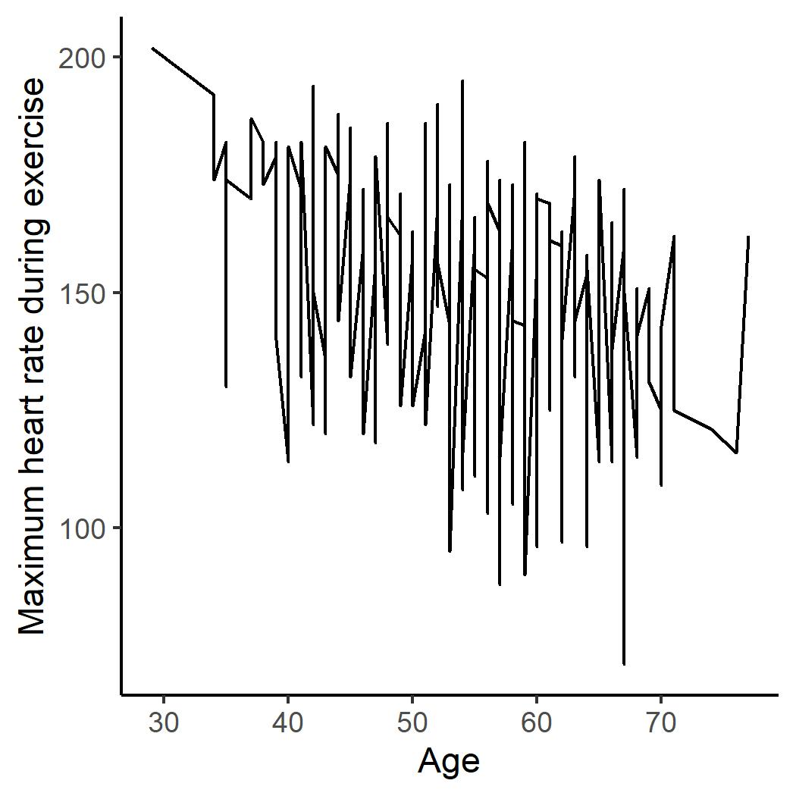
Lines connect the dots
Technically, any scatter plot could be a line plot

Slide 8
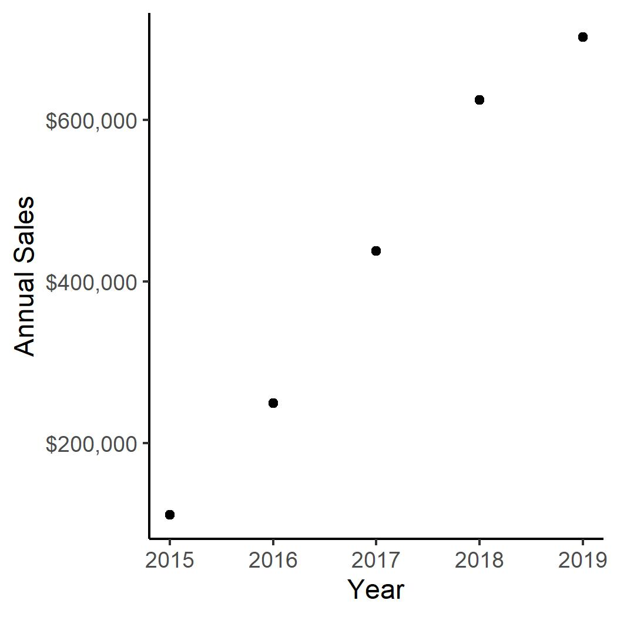
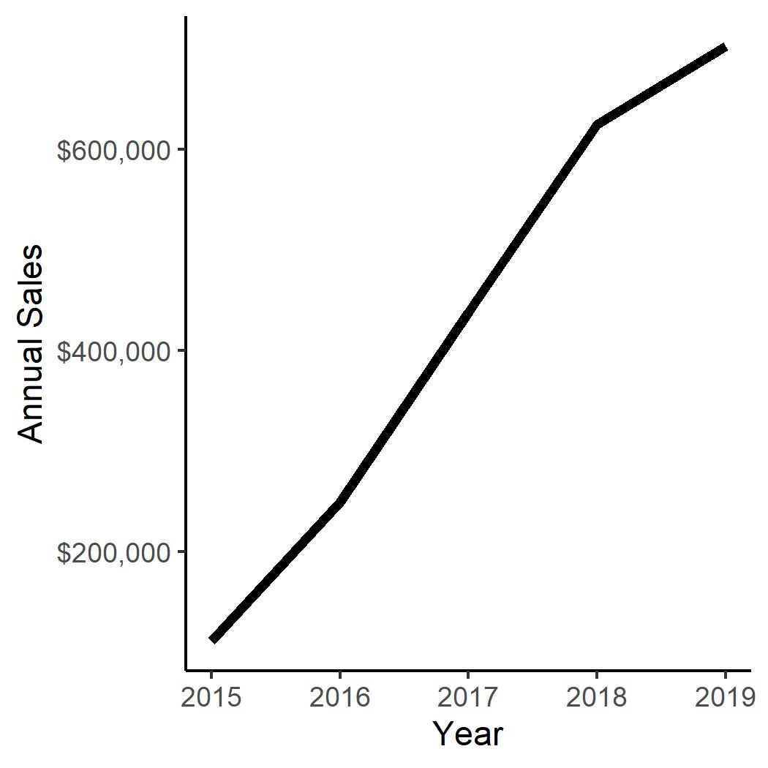
Lines connect the dots (when appropriate)

Slide 9
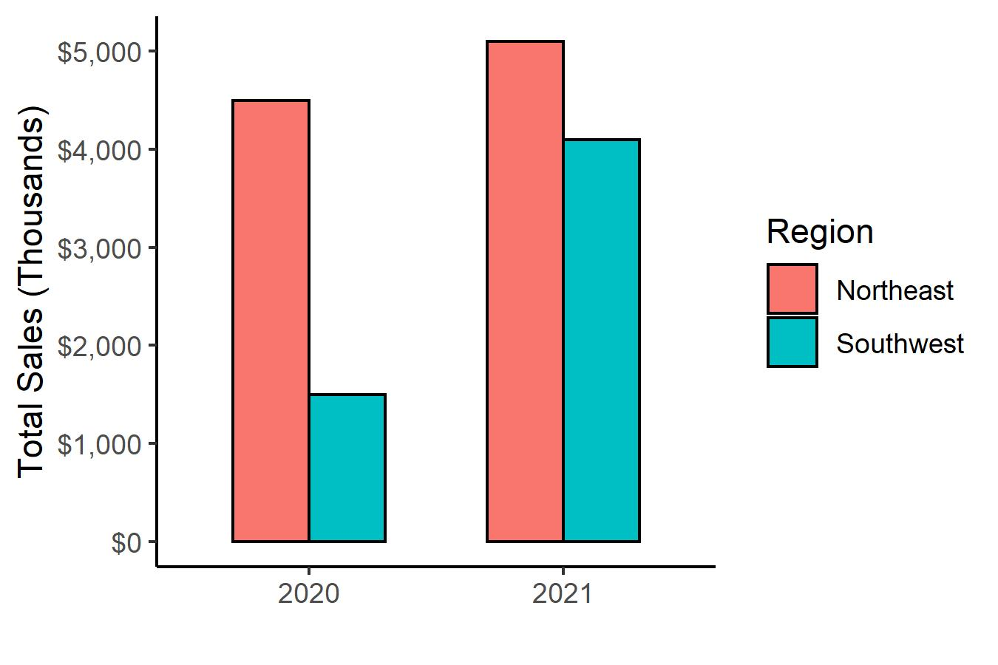
We can use color, other attributes to add detail
Year | Northeast | Southwest | Total
2020 | $4,500 | $1,500 | $6,000
2021 | $5,100 | $4,100 | $9,200

Slide 10
Summary: When to use which?
Bars
Dots
Lines

